Slide 1
General Chemistry
Course: CHE 111
Chapter: Organic Reactions
Dr. Md. Aslam Hossain
Professor
Dept. of Pharmaceutical Chemistry
Faculty of Pharmacy
University of Dhaka

Slide 2
History of Organic Chemistry
“Organic” – derived from living organism (In 1770, Torbern Bergman, Swedishchemist). Organic chemistry is the study of compounds extracted from living organisms and such compounds needed “vital force” to create them. Thus, the name organic chemistry came from the word organism.
Prior to 1828, all organic compounds had been obtained from organism or their remains, i.e. from the living systems. It was believed that organic compounds could only be synthesized in living systems through vis-vitalis- the “life force” which is known as “Vitalism” theory.
Vitalism theory stated that a vital force/life force was necessary to make an organic compounds
According to this theory, the scientific philosophy was that the synthesis of organic
compounds could only be produced within living matters while inorganic compounds
were synthesized from non-living matters. That is the vital force which existed within
organic materials but did not exist in any inorganic materials.
Upto 1828, the vital force theory was unchallenged but in 1828, the first step in the decline of the vital force theory was done by a German chemist Friedrich Wohler. He was succeeded to synthesis an organic compounds in the laboratory from inorganic starting material. He was trying to make ammonium cyanate from silver cyanate and ammonium chlroride.

Slide 3
Ag CNO + NH₄Cl
NH₄CNO + Ag Cl
H
+
H
O
H
H
Heat
H
N
CNO
N
N
C
H
H
H
Ammonium cyanate (expected product)
Urea (observed product)
The product he isolated from this reaction had none of the properties of cyanate
compounds, rather was identical to urea, a biological compounds, i.e. a component
of urine in many animals
After this experiment, organic chemistry has undergone a substantial changes and this results led to the synthesis of a variety of organic compounds from inorganic starting materials. As a result, the theory of vital force was disappeared and that any relevance to organic chemistry.

Slide 4
It had become evident that most of the organic compounds obtained from living
systems (e.g. plants or animals) contain carbon, it is therefore temting to identify
Organic chemistry as the Chemistry of Carbon
Is this defination of organic chemistry comply with the followings?
CaCO₃, CS₂
CO₂, KCN
Diamond
Grafite
Elementary form of carbon
Therefore, organic chemistry is defined as the chemistry of compounds that
contain both carbon and hydrogen
Today, chemist consider organic compounds to be those that contain carbon and one
or more other elements, most often hydrogen, oxygen, nitrogen, sulfur, phosphorus
and sometimes others as well.
So, organic chemistry is defined as the chemistry of carbon and
its compounds

Slide 5
Organic chemistry is defined as the chemistry of carbon and its compounds.
Therefore, the compounds of carbon are the central substances of which all living things on this planet are made.
DNA: The giant molecules that contain all the genetic information for a given species.
Proteins: blood, muscle, and skin.
Enzymes: catalyze the reactions that occur in our bodies.
Food: Furnish the energy that sustains life.
We live in an Age of Organic Chemistry:
Food we eat
Clothing: natural or synthetic substance
Household items
Medicines
Paint and plastic
Automobiles
Paper and ink
Pesticides
Pollutions
Insecticides: natural or synthetic substance.
Polychlorinated biphenyls (PCBs)
Dioxins
CFCs

Slide 6

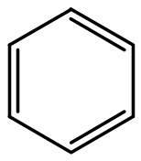

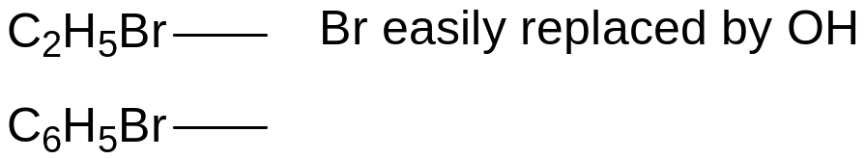
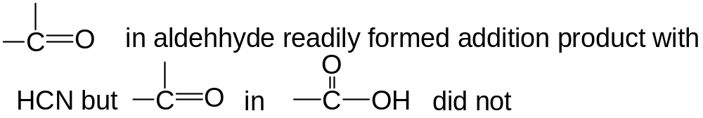
ORGANIC REACTIONS AND THEIR MECHANISMS
Classical Structural Theory of Organic Reactions
Classical structural theory is that the chemical behavior of an organic compound is determined by the functional groups in the molecules. Thus, the course of an organic reaction could be easily interpreted by indicating the interaction between functional groups of reacting molecules.
Incompetence of the classical structural theory
addition products easily
did under forced condition
Br can not be replaced by OH

Slide 7
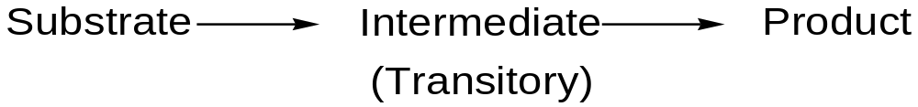
Reaction Mechanism -- Fundamental Aspects
Substrate: A substrate may be defined as the reactant that contain carbon atoms some of whose bonds with other atoms are broken and some new bonds are formed as a result of reaction with an attacking agent.
The carbon bonds in the substrate molecule are broken or cleaved to give fragments which are very reactive and constitute transitory intermediate. At once they may react with other similar species or with molecules in their environment, thus establishing the new bonds to give product.
Attacking agents: For a mechanistic approach, an organic reaction is believed to take place by the attack of a reagent on a compound containing carbon (substrate) and the reagent is known as attacking agents.
Attacking reagent bear either +ve or -ve charge. Therefore, attacking agent will not attack the substrate successfully unless the latter somehow possessed oppositely charged center in the mole.
Substrate molecule must develop polarity on some of its carbon atoms and constituents linked together. Polarity is developed by the displacement of bonded electrons.

Slide 8
Electronegativity:
An element that tends to acquire rather than lose electrons in its chemical interactions is said to
be elecctronegative.
Electronegativity is a measure of the tendency of an atom in a molecule to attract electrons to
itself (away from its bond partner) i.e. the ability of an atom to attract its outer/valance electrons.
For example, AB, a molecule joined by a pair of electrons
A : B
A : B
The two electrons are half-way between
the nuclei of A and B which exert equal
attraction on electrons and hence
electronegativities of A and B are equal
The two electrons are nearer A which implies
that they attracted more by A than by B and
the electronegativity of A is somewhat greater
than that of B
Electronegativity depends on two factors (i) its nuclear charge i.e. the number of protons in the
nucleus (atomic number) (ii) the distance of the valance shells (number of shells containing the
electrons) i.e atomic radius.
The greater number of protons
The greater positive charge
Increased Electronegativity
Increased attraction between
oppositely charged particles
Decreased distance between
the particles, decreased radius
Increased Electronegativity
F
Left to right of
the periodic table
Li Be B C N O F
Cl
Increasing of
electronegativity
Bottom to top of
the periodic table
Increasing of
electronegativity
Br
I

Slide 9
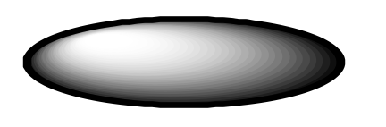
Polarity: When a covalent is formed between two atoms with different electronegativities, the
electrons involved in the bond are not equally shared. The atom with higher electronegativity
will exert higher attractive pull on the shared electrons closer to it, i.e. the electron density in
the molecular orbital would be greater around the atom with higher electronegativity. Thus,
three will be a relatively negative in one end and a relatively positive in other end, i.e. there is
a negative and a positive pole. Thus the molecules having such a bond develops polarity and
this type of covalent bond is known as polar bond.
δ+
δ-
Electronegativity of Hydrogen 2.1
Electronegativity of Flourine 4
H
F
H
F
When a covalent is formed between two atoms with same electronegativities, the electrons involved in the bond are equally shared. The electron density in the molecular orbital binding the two atoms together is same around each atom. There is no positive or negative end. Such bond is known as Nonpolar bond.
For examples, C-C, H-H

Slide 10
Polarity of Molecules: A molecule is said to be polar when it contain one or more polar bonds and the center of the negative charge does not coincide with the center of the positive charge i.e. the polar bonds must be so directed that there are separate centers of positive
and negative charges in the molecules.
Polar molecules posses a dipole moment with two equal and opposite charges separated in
space. The dipole moment is the product of the magnitude of the charges and the distance
between the centers of the charges.
Dipole moment (m) = charge (e) x distance (d)
Centre of positive
and negative charge
δ-
Centre of positive
and negative charge
Cl
Centre of positive charge
δ-
δ+
δ+
δ-
Cl
C
Cl
H
H
δ+
O = C = O
O
Polar
δ-
δ+
δ-
δ-
Cl
Non polar
δ-
δ-
Non polar
Centre of
negative charge
Cl
H
H
C
H
H
C
H
δ+
Polar
Non polar
H
H

Slide 11
Intermolecular Forces: There are two types of intermolecular forces
Dipole-dipole interactions (ii) van der Waals Forces
Dipole-dipole interactions: It is the interaction of the positive end of one polar molecule for the
negative pole of another polar molecule. As a result of dipole-dipole interaction, the polar
molecules held each other more strongly than the non polar molecules.
δ+
δ-
δ+
δ-
δ+
δ-
H
F
H
F
H
F
An especially strong kind of dipole-dipole interaction is hydrogen bonding, in which a
hydrogen atom serve as bridge between two electronegative atoms (O, N, F), holding one
by a covalent bond and the other by electrostatic forces
H
O
H
O
H
O
H
H
H
Effect of hydrogen bond: Hydrogen bond has an important effects on boiling point, solubility
and the shape of large biomolecules.

Slide 12
Electrophiles: An agent which can accept an electron pair in a reaction is called electrophile.
Electrophiles are electron-deficient. The name electrophile means (electro = electrons and
philic = loving) “electron-loving” and indicates that it attacts regions of high electron density
(negative centre) of the substrate molecules.
Electrophiles
H
Positive electrophiles
Neutral electrophiles
F
Cl
H
C+
+
They are deficient
of two electrons and
carry a positive charge
Neutral molecules with
electron deficient centre
:
:
F
B
Cl
Al
Br
H
:
F
Cl
Nucleophile: An agent which can donate an electron pair in a reaction is called nucleophile.
Nucleophiles are electron rich. The name nucleophile means (nucleo = nucleus and
philic = loving) “nucleus-loving”. Since the nucleus is electrically positive, the nucleophile
will attacts regions of low electron density (positive centre) of the substrate molecules
Nucleophiles
H
H
Negative Nucleophiles
Neutral Nucleophiles
-
H
N:
H
C:
:
An excess electron pair
and carry a negative charge
Posses spare electron
pair and no charge
:
:
Br
H
H
:

Slide 13
Bond Fission: Bond fission means separation of two atoms from each other in a covalently bonded molecule.
Bond Fission
Homolytic fission
Heterolytic fission
One of the atoms acquire both of the bonded electrons because A is more electronegative than B which thereby acquires both the bonding electrons
and becomes negatively charged.
Light
Energy
Each of the atoms acquire one of the bonded electrons

Slide 14
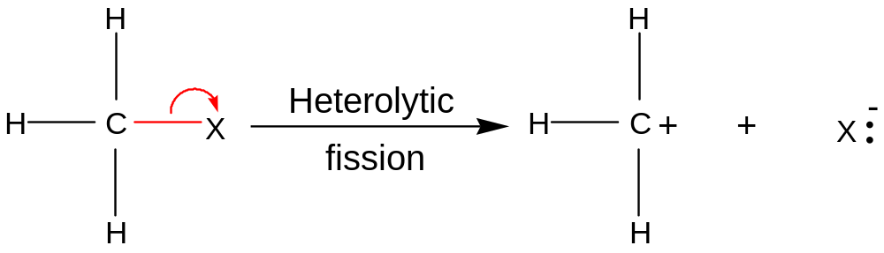
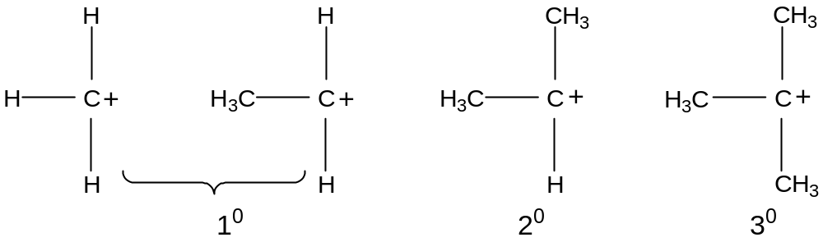
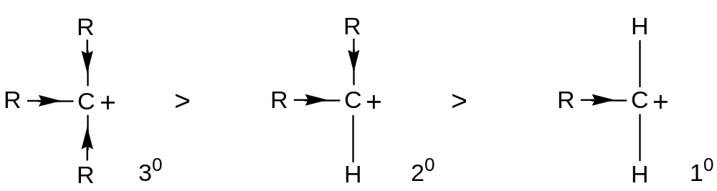
Carbonium Ions: An organic ion containing a positively charged carbon atom is called a carbonium ion

Slide 15
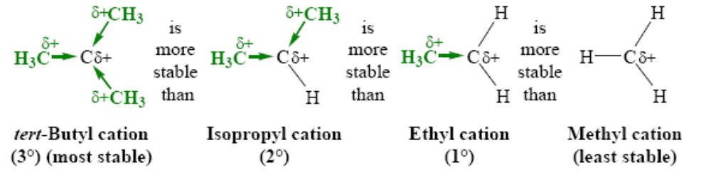

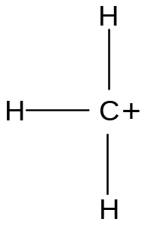
THE RELATIVE STABILITIES OF CARBOCATIONS
Carbanium ion being deficient in electrons is very unstable. Electron realising group such as alkyl group adjacent to the carbon atom makes the carbanium ion stable by partial neutraliztion of the positive charge on carbon
Alkyl groups, when compared to hydrogen atoms, are electron releasing thus the order of stability of carbocations parallel the number of attached alkyl / methyl groups.
>
The relative stabilities of carbocations is 3° > 2° > 1° > methyl

Slide 16
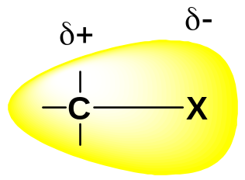
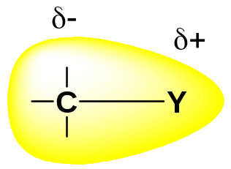







Standard
-I Effect
+I Effect
H
H
C
H
H
-I Effect group (electron
attracting/withdrawing group):
NO₂ > F > COOH > Cl >
Br > I > OH > C₆H₅
+I Effect group (electron
resealing group):
(CH₃)₃C- > (CH₃)₂CH- >
CH₃CH₂⁻ > CH₃-
γ---β---α
C--C---C---X
-I Effect
+I Effect

Slide 17
Free redicals: An atom or group of atoms possessing an odd (unpaired) elctrons is known
as free redical. A dot generally represents the odd electrons, the symbol of free redical.
They are produced by homolytic fission of the molecule
Light/heat
.
.
A : B
A +
B
:
:
:
:
:
:
:
.
:
:
.
Cl
Cl
Cl
+
Cl
:
:
:
:
Free redicals are extremely reactive because:
(i) It tendency to gain an additional electrons to restore stable bonding pair
(ii) Energy was supplied to each atom during the cleavage of bond of the molecules and this
energy rich particles tend strongly to lose energy by the formation of a new chemical bond

Slide 18
Inductive effect: The permanent effect whereby polarity is induced on the carbon atom and
the substituent attached to it due to minor displacement of bonding electron pair caused by
their different electronegativities, is known as inductive effect or simply as I-effect.
Inductive effect (I effect) refers to polarity produced in a molecule as a result of higher
electronegativity of one atom compared to other
Inductive effect
Negative Inductive
Effect (- I effect)
Positive Inductive
Effect (+ I effect)
The substituent bonded to carbon atom is electron attracting /withdrawing group, it develops negative charge and the inductive effect is called negative inductive effect (-I effect)
The substituent bonded to carbon atom which loses electrons toward carbon atom (electron releasing group), it develops positive charge and the inductive effect is called positive inductive effect (+I effect)

Slide 19
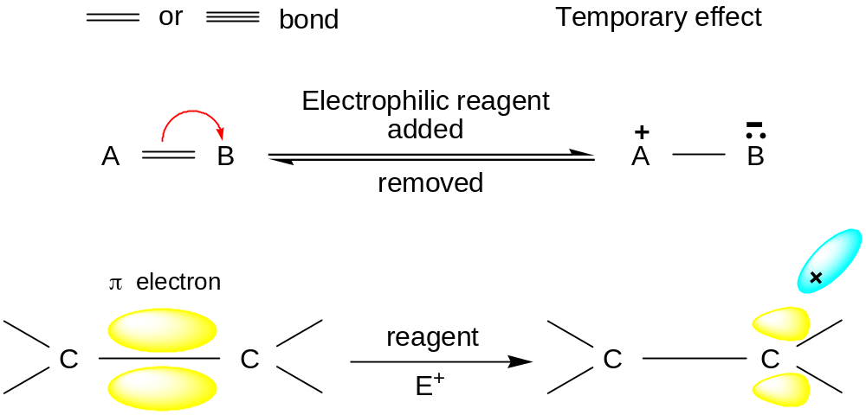
Electromeric effects: The effect which causes a temporary polarization in the substrate at the seat of a multiple bond by shift of an electron pair from one atom to other under the influence of an eletrophillic agent is called electrometric effect.
When a double or triple bond is exposed to attack by an electrophillic agent, a pair of bonding electron is transferred completely from anoe atom to another. The atom that takes the electron pair becomes negatively charged and the other develops positive charge.

Slide 20
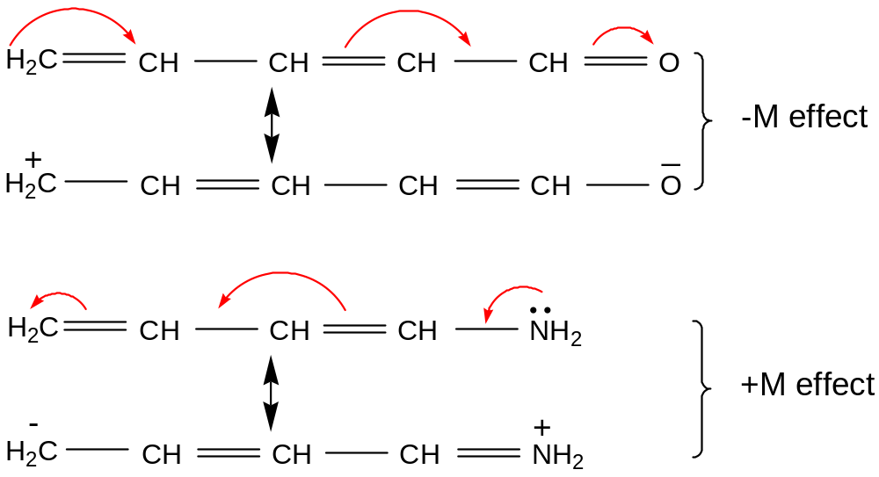
Mesomeric effect: When an electron withdrawing or pumping group is conjugated with a π bond or a set of alternately arranged σ and π bonds, the electron displacement is transmitted trough the π electrons in the chain. The π electrons will be displaced to more electronegative atoms gives resonance in a molecule and thus develops polarity in
a molecule.

Slide 21
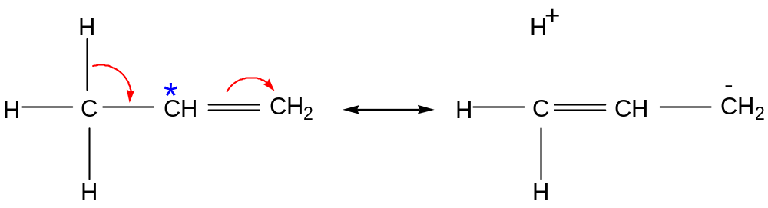
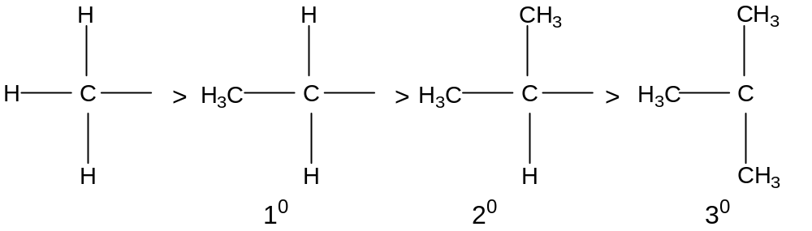
Hyperconjugative effect: Hyperconjugation effect takes place through the interaction of σ electrons of C-H bond with π electrons of the double bond.
Greater the number of C-H bonds at α position to the unsaturated system, greater would be the electron release towards the terminal C (* mark) creating high electron density.

Slide 22
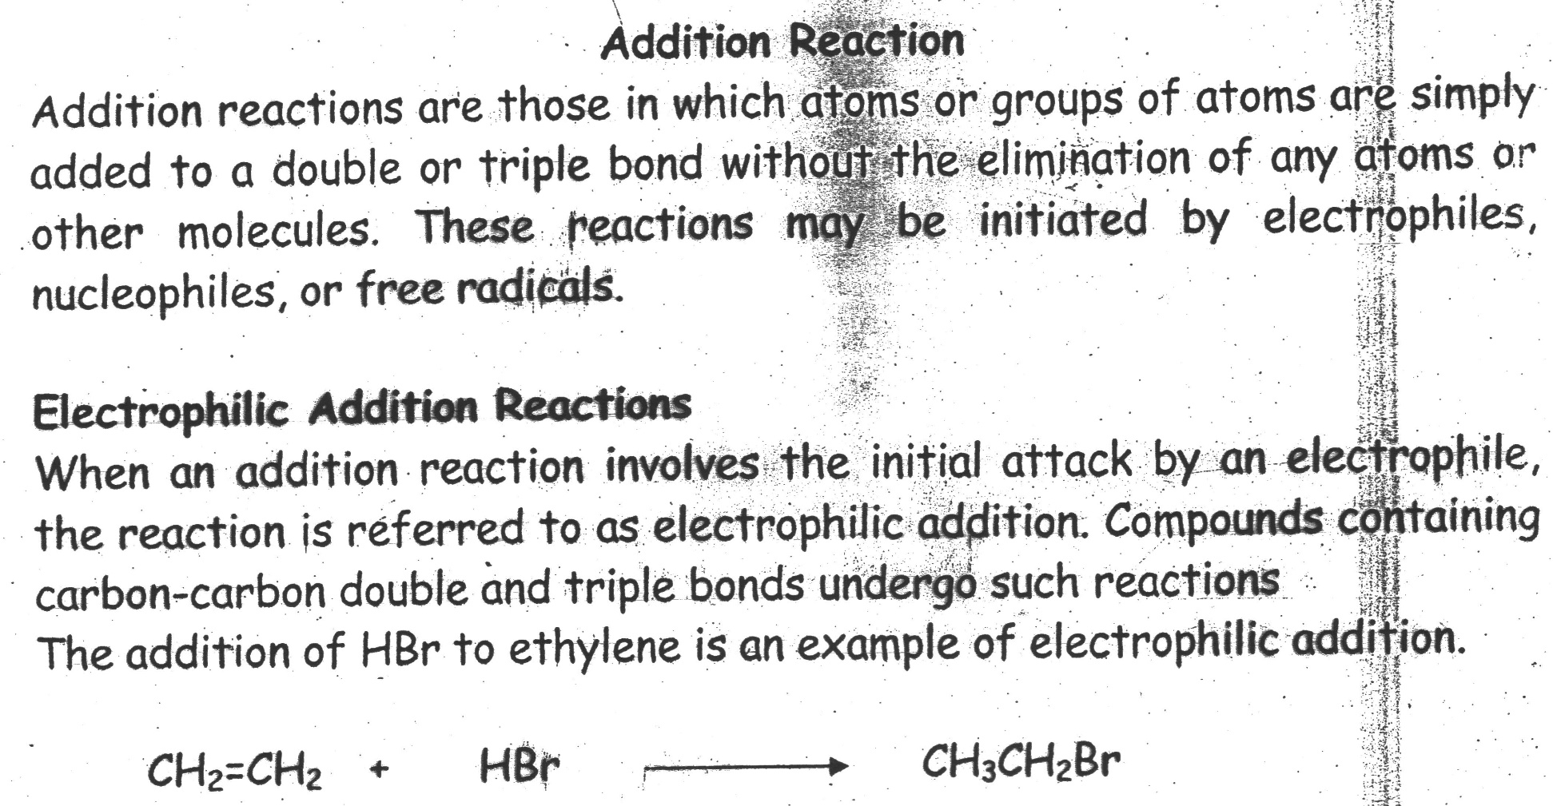
Types of Reactions
Addition reaction
Substitution reaction
Elimination reaction
Rearrangement reaction

Slide 23
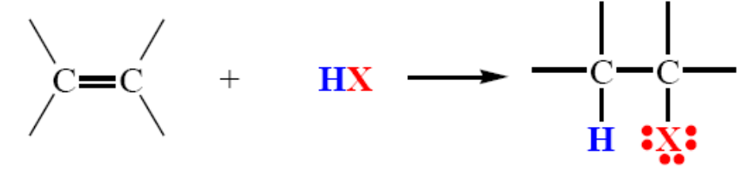
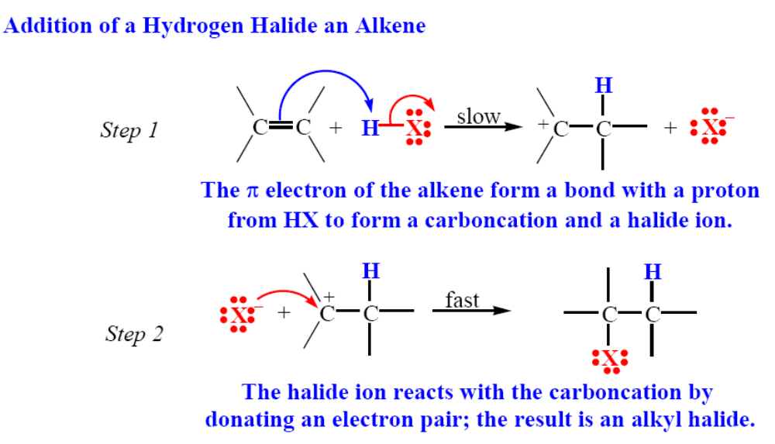
ADDITION OF HYDROGEN HALIDES TO ALKENE
Hydrogen halides (HI, HBr, HCl, and HF) add to the double bond of alkenes:

Slide 24
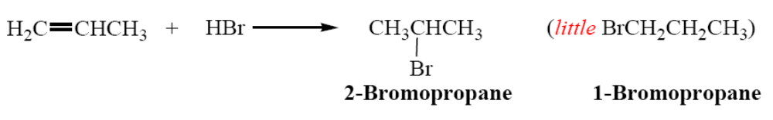
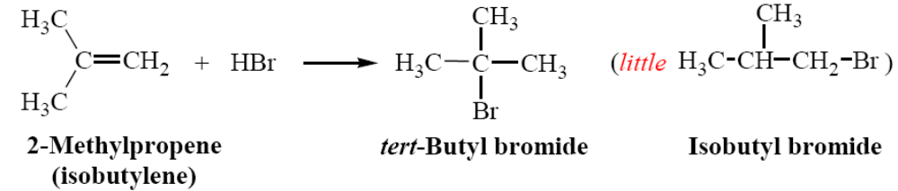
The regioselectivity of the addition of HX to an unsymmetrical alkenes: The addition of HBr to propene: the main product is 2-bromopropane.
REGIOSELECTIVE REACTIONS: When a reaction that can potentially yield two or more constitutional isomers actually produces only one (or a predominance of one), the reaction is said to be regioselective.

Slide 25
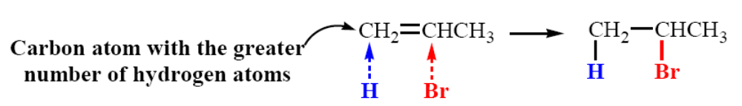
MARKOVNIKOV’S RULE
Russian chemist Vladimir Markovnikov in 1870 proposed the following rule:
“If an unsymmetrical alkene combines with a hydrogen halide, the halide ion adds to the carbon atom with fewer hydrogen atoms” (The addition of HX to an alkene, the hydrogen atom adds to the carbon atom of the double that already has the greater number of hydrogen atoms).

Slide 26
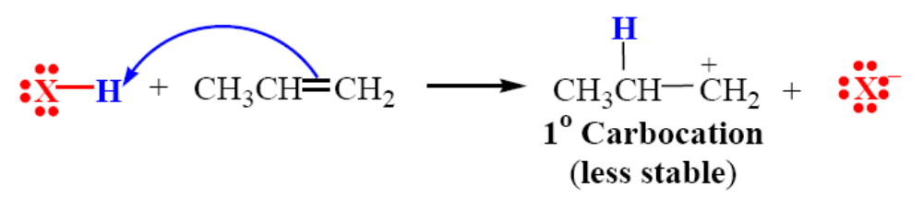
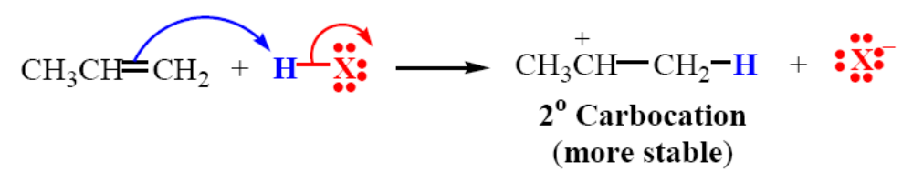
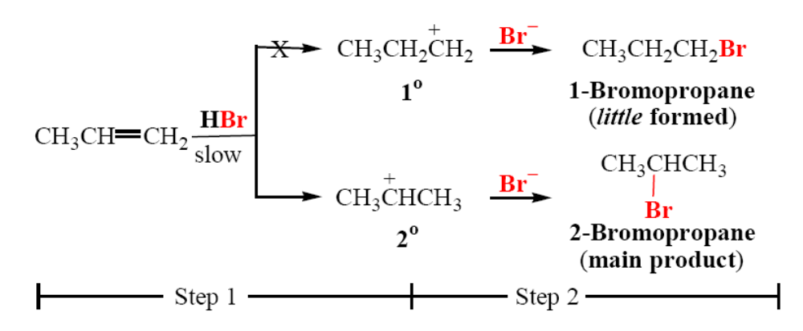
THEORETICAL EXPLANATION OF MARKOVNIKOV’S RULE:
Step 1: Addition reaction of HX to an unsymmetrical alkene could conceivably lead to two different carbocations:
Step 2: These two carbocations are not of equal stability. The 2° carbocation is more stable accounts for the correct predication of the overall addition by Markovnikov’s rule. The more stable 2° carbocation is formed preferentially and the chief product is 2-bromopropane.

Slide 27

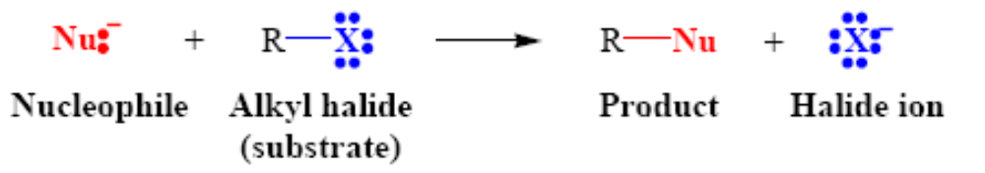
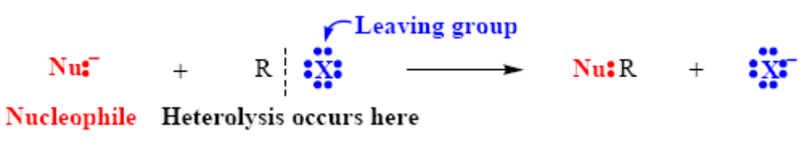
Nucleophilic substitution is a fundamental class of substitution reaction in which an "electron rich" nucleophile selectively bonds with or attacks the positive or partially positive charge of an atom attached to a group or atom called the leaving group.
In nucleophilic substitution reactions, the C–X bond of the substrate undergoes heterolysis, and the lone-pair electrons of the nucleophile is used to form a new
bond to the carbon atom
A nucleophile is an the electron rich species that will react with an electron poor species. A leaving group , LG, is an atom (or a group of atoms) that is displaced
as stable species taking with it the bonding electrons.

Slide 28
S_{N}2 reaction: When the rate of a nucleophilic substitution reaction depends on both of the concentration of substrate and nucleophile is known as S_{N}2 reaction. In S_{N}2 reaction, a lone pair of electron from a nucleophile attacks an electron deficient electrophilic center and bonds to it, expelling another group called a leaving group. Thus the incoming group replaces the leaving group in one step. Since two reacting species are involved, rate-determining step of the reaction, this leads to the name bimolecular nucleophilic substitution, or S_{N}2.
Kinetics: The rate of the reaction depends on the concentration of substrate and the concentration of nucleophile. Rate of reaction ∝ [Substrate] [Nucleophile]. Thus,
the reaction is bimolecular i.e. two species are involved in the rate-determining step.
Reaction order: The reaction is second order overall
The S_{N}2 reaction: Substitution, Nucleophilic, bimolecular

Slide 29
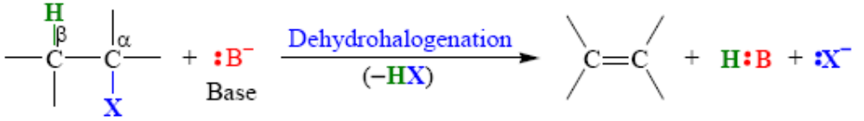
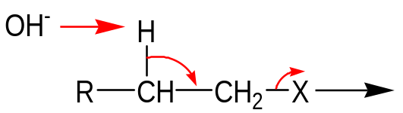


Elimination reactions: Two or four atoms or groups attached to the adjacent carbon atoms in the substrate molecule are eliminated to form a multiple bond. Elimination reactions are important as a method for the preparation of alkenes. The two most elimination reactions are:
Dehydration (-H₂O) of alcohols, and
Dehydrohalogenation (-HX) of alkyl halides.
Dehydrohalogenation involves the elimination of the halogen atom and of a hydrogen atom from a carbon adjacent to the one losing the halogen. The reagent required is a base, whose function is to abstract the hydrogen as a proton.
Dehydrohalogenation is a β elimination or1,2-elimination reaction because the carbon holding the halogen is designated as α or 1-carbon and elimination involves the loss of β or 2-hydrogen from β or 2-carbon adjacent carbon holding the halogen.
2
1
+
There are three fundamental events in these elimination reactions:
Removal of a proton
Formation of the CC π bond
Breaking of the bond to the leaving group

Slide 30
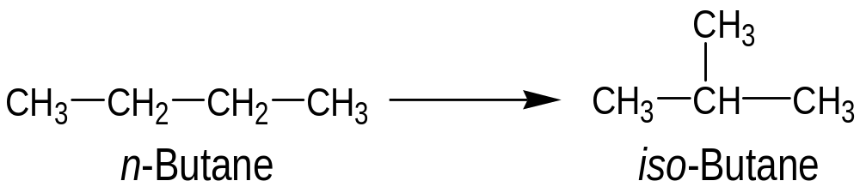
Rearrangement Reaction
A rearrangement reaction is a broad class of organic reactions where the carbon skeleton of a molecule is rearranged to give a structural isomer of the original molecule.
The reactions which proceed by a rearrangement or reshufling or shifting of atoms/groups from one position to another in the molecule to produce a
structural isomer of the original substance are called rearrangement reaction.
Intramolecular rearrangement
Intermolecular rarrangement

